Slide 1
Memory Management
UNIT 4
Basic memory management
Requirements
Memory Partitioning
Buddy Systems
Relocation
Paging, Segmentation
Virtual memory : HW and Control
Structures
OS software

Slide 2
Memory Management
Ideally programmers want memory that is
large
fast
non volatile
Memory hierarchy
small amount of fast, expensive memory – cache
some medium-speed, medium price - main memory
gigabytes of slow, cheap - disk storage
Memory manager handles the memory hierarchy

Slide 3
Memory Management Requirements
Memory management keeps track of the status of each memory location, whether it is allocated or free. It allocates the memory dynamically to the programs at their request and frees it for reuse when it is no longer needed. Memory management meant to satisfy some requirements that we should keep in mind

Slide 4
Memory Management is the process of controlling and coordinating computer memory, assigning portions known as blocks to various running programs to optimize the overall performance of the system.

Slide 5
It is the most important function of an operating system that manages primary memory. It helps processes to move back and forward between the main memory and execution disk. It helps OS to keep track of every memory location, irrespective of whether it is allocated to some process or it remains free

Slide 6
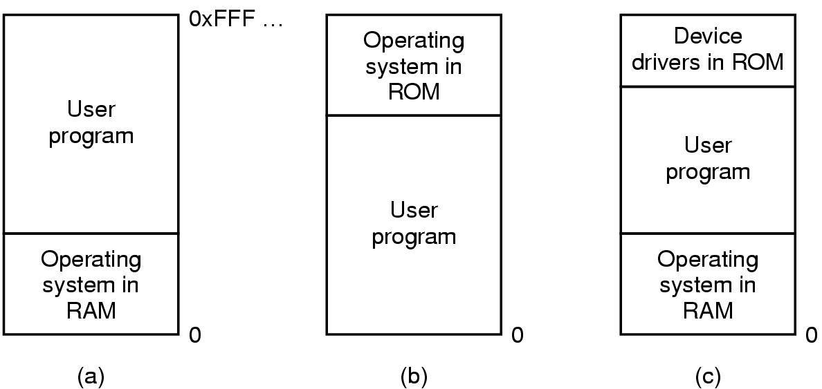
Basic Memory Management Monoprogramming without Swapping or Paging
Three simple ways of organizing memory
- an operating system with one user process

Slide 7
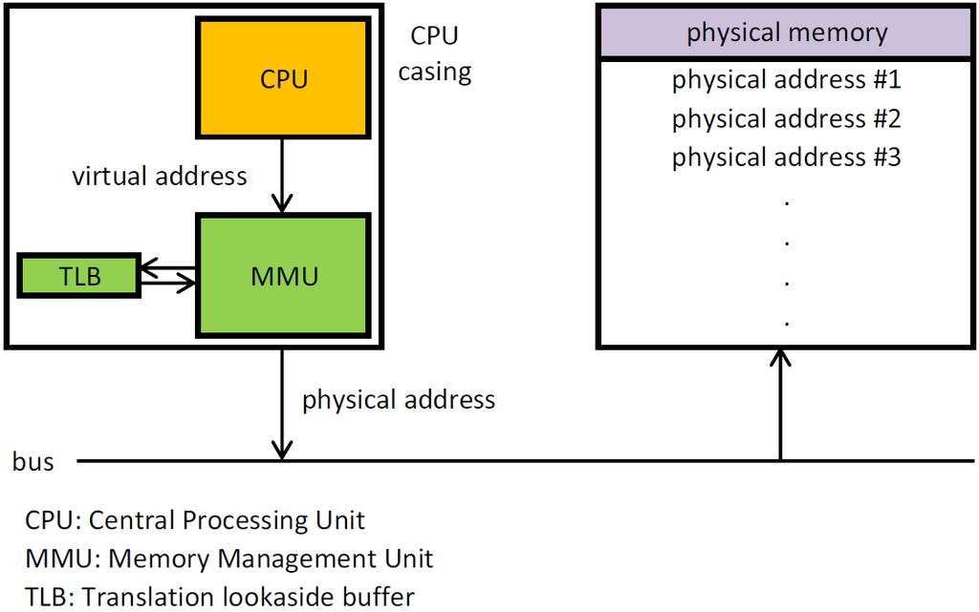
MMU Block diag.

Slide 8
IMP Terms
Swapping
Fragmentation
Compaction
Paging

Slide 9
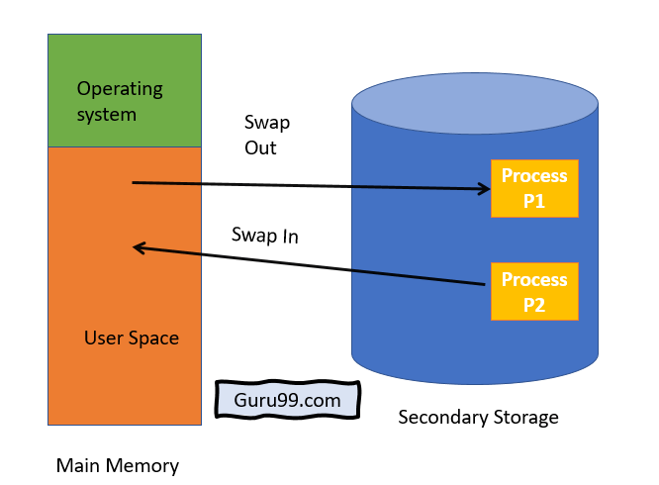
Swapping

Slide 10
Swapping is a method in which the process should be swapped temporarily from the main memory to the backing store. It will be later brought back into the memory for continue execution.
Backing store is a hard disk or some other secondary storage device that should be big enough in order to accommodate copies of all memory images for all users. It is also capable of offering direct access to these memory images.

Slide 11
Fragmentation
Processes are stored and removed from memory, which creates free memory space, which are too small to use by other processes.
After sometimes, that processes not able to allocate to memory blocks because its small size and memory blocks always remain unused is called fragmentation. This type of problem happens during a dynamic memory allocation system when free blocks are quite small, so it is not able to fulfill any request.

Slide 12
Two types of Fragmentation methods are:
1. External fragmentation 2. Internal fragmentation
External fragmentation can be reduced by rearranging memory contents to place all free memory together in a single block.
The internal fragmentation can be reduced by assigning the smallest partition, which is still good enough to carry the entire process

Slide 13
Compaction
In compaction OS reallocates the existing programs in contiguous regions & creates a large enough free area for allocation to a new process.

Slide 14
Paging
Paging is a storage mechanism that allows OS to retrieve processes from the secondary storage into the main memory in the form of pages. In the Paging method, the main memory is divided into small fixed-size blocks of physical memory, which is called frames. The size of a frame should be kept the same as that of a page to have maximum utilization of the main memory and to avoid external fragmentation. Paging is used for faster access to data, and it is a logical concept.

Slide 15
Memory Partitioning
Memory partitioning is the system by which the memory of a computer system is divided into sections for use by the resident programs. These memory divisions are known as partitions. There are different ways in which memory can be partitioned: fixed, variable, and dynamic partitioning.

Slide 16
Memory Partitioning

Slide 17
Fixed partitioning
This is the oldest and simplest technique used to put more than one process in the main memory. In this partitioning, the number of partitions (non-overlapping) in RAM is fixed but the size of each partition may or may not be the same. As it is a contiguous allocation, hence no spanning is allowed

Slide 18
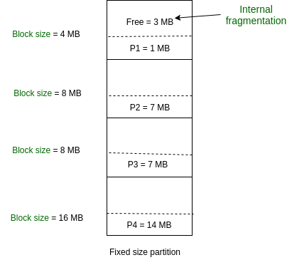

Slide 19
Dnamic Memory Partitioning
Dynamic partitioning is a variable size partitioning scheme. It performs the allocation dynamically. When a process arrives, a partition of size equal to the size of process is created. Then, that partition is allocated to the process

Slide 20
Disadvantage
Difficult Implementation: Implementing variable Partitioning is difficult as compared to Fixed Partitioning as it involves allocation of memory during run-time rather than during system configure. External Fragmentation: There will be external fragmentation inspite of absence of internal fragmentation.

Slide 21
Dynamic Storage-Allocation Problem
How to satisfy a request of size n from a list of free holes.
First-fit: Allocate the first hole that is big enough.
Best-fit: Allocate the smallest hole that is big enough; must search entire list, unless ordered by size. Produces the smallest leftover hole.
Worst-fit: Allocate the largest hole; must also search entire list. Produces the largest leftover hole.
First-fit and best-fit better than worst-fit in terms of speed and storage utilization.

Slide 22
Fragmentation
External Fragmentation – total memory space exists to satisfy a request, but it is not contiguous.
Internal Fragmentation – allocated memory may be slightly larger than requested memory; this size difference is memory internal to a partition, but not being used.
Reduce external fragmentation by compaction
Shuffle memory contents to place all free memory together in one large block.
Compaction is possible only if relocation is dynamic, and is done at execution time.
I/O problem
Latch job in memory while it is involved in I/O.
Do I/O only into OS buffers.

Slide 23
Buddy System
Buddy allocation system is an algorithm in which a larger memory block is divided into small parts to satisfy the request. This algorithm is used to give best fit. Benefit of this technique is that the two buddies can combine to form the block of larger size according to the memory request.

Slide 24
Advantages -
Easy to implement a buddy system
Allocates block of correct size
It is easy to merge adjacent holes
Fast to allocate memory and de-allocating memory
Disadvantage –
It requires all allocation unit to be powers of two
It leads to internal fragmentation

Slide 25
Logical vs. Physical Address Space
The concept of a logical address space that is bound to a separate physical address space is central to proper memory management.
Logical address – generated by the CPU; also referred to as virtual address.
Physical address – address seen by the memory unit. Logical and physical addresses are the same in compile-time and load-time address-binding schemes; logical (virtual) and physical addresses differ in execution-time address-binding scheme.

Slide 26
Paging
Logical address space of a process can be noncontiguous; process is allocated physical memory whenever the latter is available.
Divide physical memory into fixed-sized blocks called frames (size is power of 2, between 512 bytes and 8192 bytes).
Divide logical memory into blocks of same size called pages.
Keep track of all free frames.
To run a program of size n pages, need to find n free frames and load program.
Set up a page table to translate logical to physical addresses.
Internal fragmentation.
PAGE TABLE TRANSLATES LOGICAL addr to PHYSICAL addr

Slide 27
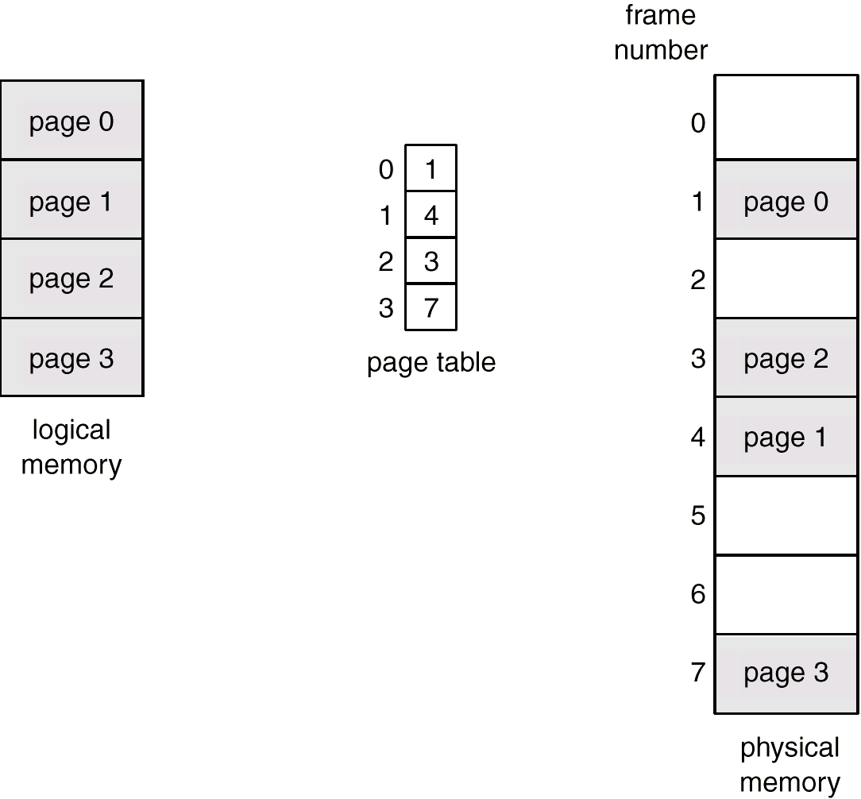
Paging Example

Slide 28
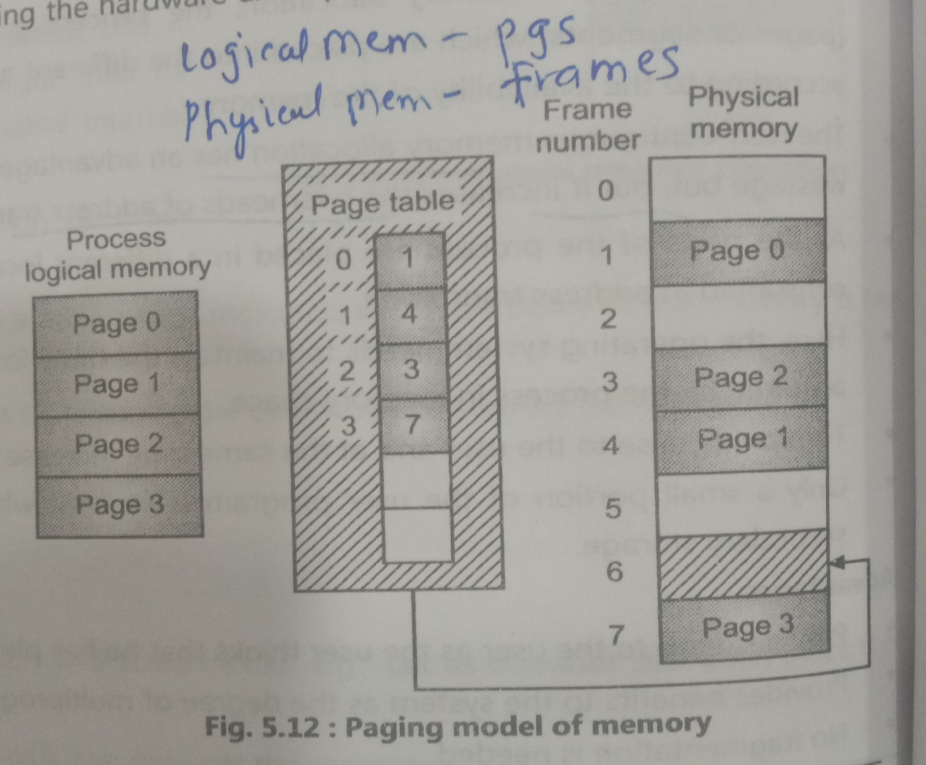

Slide 29
Operating system software
page replacement strategies are different schemes in OS software

Slide 30
Page replacement scheme
The page replacement scheme / algorithm decides which memory page is to be replaced.
The process of replacement is sometimes called swap out or write to disk. Page replacement is done when the requested page is not found in the main memory (page fault).

Slide 31
Page Hit – If CPU tries to retrieve the needed page from main memory, and that page is existed in the main memory (RAM), then it is known as “PAGE HIT”. ...
Page fault /MISS – It occurs when a program attempts to access data or code that is in its address space, but is not currently located in the system RAM. So when page fault occurs then following sequence of events happens.

Slide 32
Since actual physical memory is much smaller than virtual memory, page faults happen. In case of page fault, Operating System might have to replace one of the existing pages with the newly needed page.
Different page replacement algorithms suggest different ways to decide which page to replace. The target for all algorithms is to reduce the number of page faults

Slide 33
Page replacement algorithms
FIFO : First in First Out
LRU : Least Recently Used
OPTIMAL PAGE REPLACEMENT
NFU ( Not frequently Used Page Replacement Algo)
MFU ( Most frequently Used Page Replacement Algo)
second chance replacement

Slide 34
FIFO
This is the simplest page replacement algorithm. In this algorithm, the operating system keeps track of all pages in the memory in a queue, the oldest page is in the front of the queue. When a page needs to be replaced page in the front of the queue is selected for removal.

Slide 35
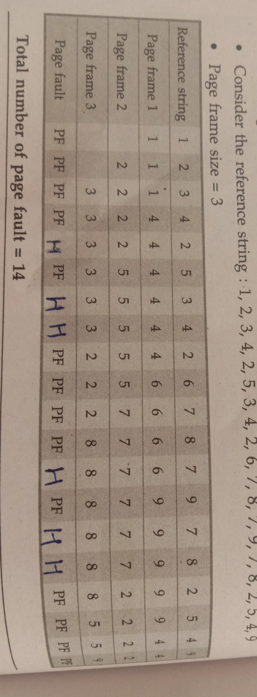
FIFO Example

Slide 36
Page faults =
Page hits =
Hit ratio = total no of hits / total no of pages

Slide 37
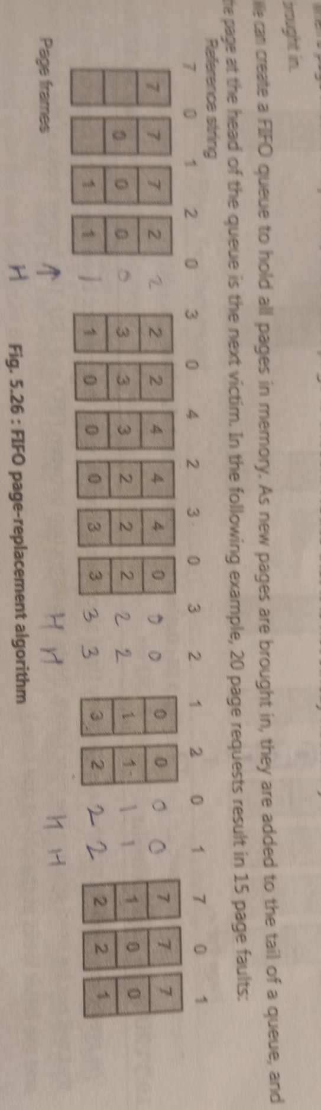
FIFO Example

Slide 38
PF = 15
Hits = 5
HR = 5/20 = 1/4

Slide 39
Least Recently Used – In this algorithm page will be replaced which is least recently used.
Optimal Page replacement – In this algorithm, pages are replaced which would not be used for the longest duration of time in the future.

Slide 40
Least Recently Used (LRU)
Assume pages used recently will be used again soon
throw out page that has been unused for longest time
Must keep a linked list of pages
most recently used at front, least at rear
update this list every memory reference !!
Alternatively keep counter in each page table entry
choose page with lowest value counter
periodically zero the counter

Slide 41
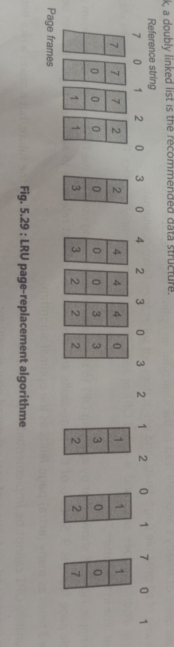
LRU Example

Slide 42
PF = 12
HIT = 8
HR = 8/20 = 2/5

Slide 43
page refe string
2 3 2 1 5 2 4 5 3 2 5 2
2 | 3 | 2 H | 1 | 5 | 2 H | 4 | 5 H | 3 | 2 | 5 H | 2 H
2 | 2 | 2 | 2 | 2 | 2 | 2 | 2 | 3 | 3 | 3 | 3
 | 3 | 3 | 3 | 5 | 5 | 5 | 5 | 5 | 5 | 5 | 5
 |  |  | 1 | 1 | 1 | 4 | 4 | 4 | 2 | 2 | 2

Slide 44
PF = 7
Hits = 5
HR = 5/12

Slide 45
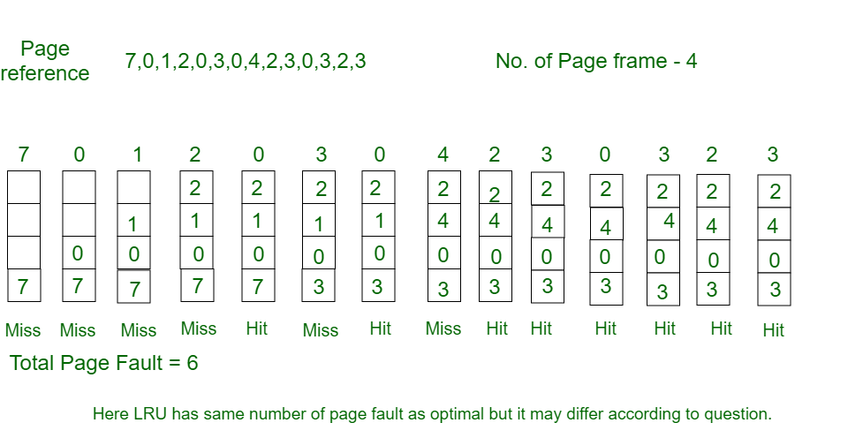
LRU

Slide 46
Optimal Page Replacemnt
Optimal page replacement is perfect, but not possible in practice as the operating system cannot know future requests. The use of Optimal Page replacement is to set up a benchmark so that other replacement algorithms can be analyzed against it.

Slide 47
Optimal Page Replacement Algorithm
Replace page needed at the farthest point in future
Optimal but unrealizable
Estimate by …
logging page use on previous runs of process
although this is impractical

Slide 48
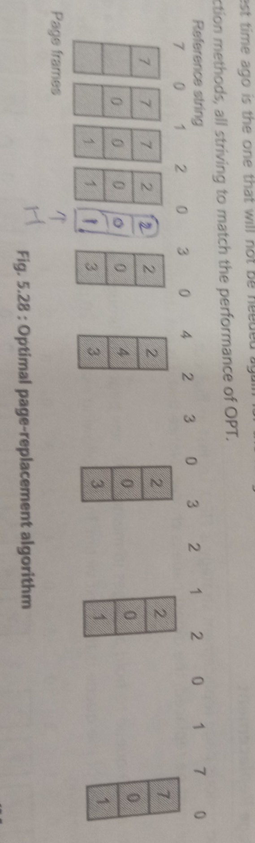
Optimal Page replacement - Example

Slide 49
page faults = 9
Hits/Miss = 11
Hit ratio = 11/20

Slide 50
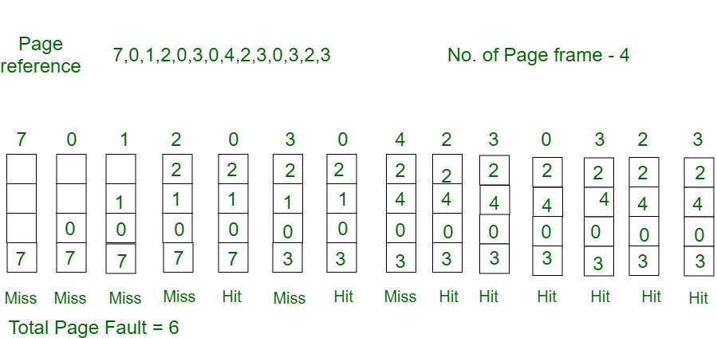

Slide 51
Hardware and control structure
demand paging
thrashing
working set model

Slide 52
DEMAND PAGING
Demand paging follows that pages should only be brought into memory if the executing process demands them. This is often referred to as lazy evaluation as only those pages demanded by the process are swapped from secondary storage to main memory.

Slide 53
Demand paging system is similar to a paging system with swapping where processes reside in secondary memory

Slide 54
Thrashing
Thrashing is caused by under allocation of the minimum number of pages required by a process, forcing it to continuously page fault. The system can detect thrashing by evaluating the level of CPU utilization as compared to the level of multiprogramming. It can be eliminated by reducing the level of multiprogramming.

Slide 55
Thrashing is a condition or a situation when the system is spending a major portion of its time in servicing the page faults, but the actual processing done is very negligible. The basic concept involved is that if a process is allocated too few frames, then there will be too many and too frequent page faults

Slide 56
A temporary solution for thrashing is to eliminate one or more running applications. One of the recommended ways to eliminate thrashing is to add more memory to main memory. Another way of resolving the issue of thrashing is by adjusting the size of the swap file

Slide 57
working set model ( Locality)
The working set model states that a process can be in RAM if and only if all of the pages that it is currently using (often approximated by the most recently used pages) can be in RAM. ... In other words, the working set strategy prevents thrashing while keeping the degree of multiprogramming as high as possible

Slide 58
all the pages in most recent page reference are the working set

Slide 59
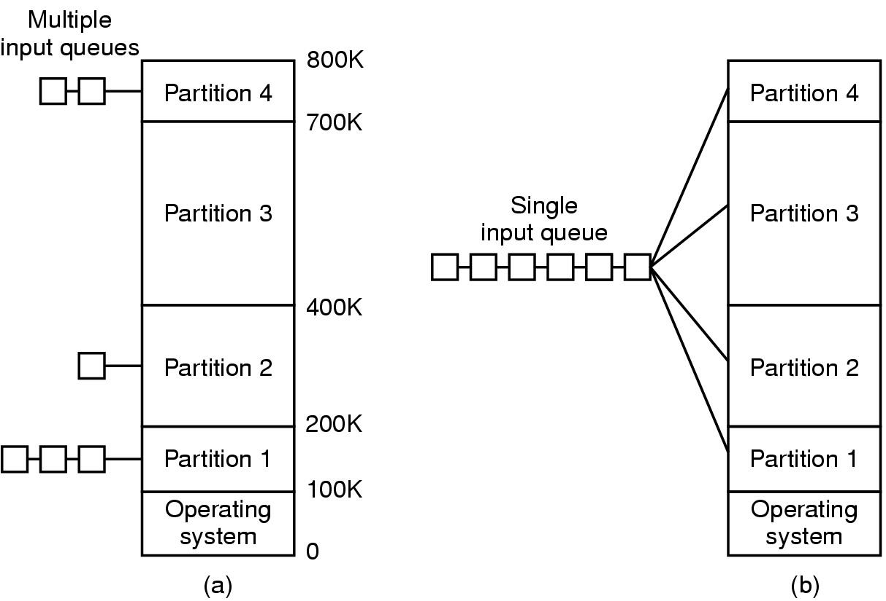
Multiprogramming with Fixed Partitions
Fixed memory partitions
separate input queues for each partition
single input queue

Slide 60
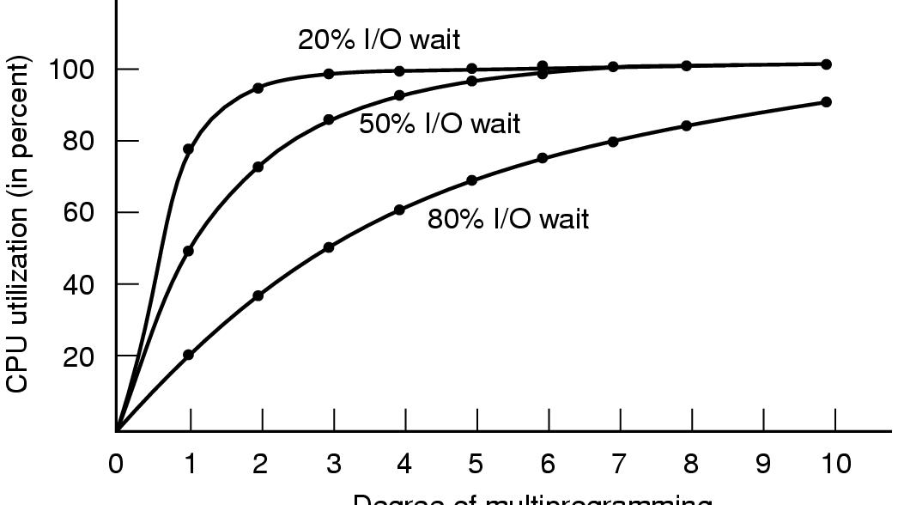
Modeling Multiprogramming
Degree of multiprogramming
CPU utilization as a function of number of processes in memory

Slide 61
Page Replacement Algorithms
Page fault forces choice
which page must be removed
make room for incoming page
Modified page must first be saved
unmodified just overwritten
Better not to choose an often used page
will probably need to be brought back in soon

Slide 62
Not Recently Used Page Replacement Algorithm
Each page has Reference bit, Modified bit
bits are set when page is referenced, modified
Pages are classified
not referenced, not modified
not referenced, modified
referenced, not modified
referenced, modified
NRU removes page at random
from lowest numbered non empty class

Slide 63
FIFO Page Replacement Algorithm
Maintain a linked list of all pages
in order they came into memory
Page at beginning of list replaced
Disadvantage
page in memory the longest may be often used

